Slide 1

Samuel Pakin’s Portfolio Report

Slide 2
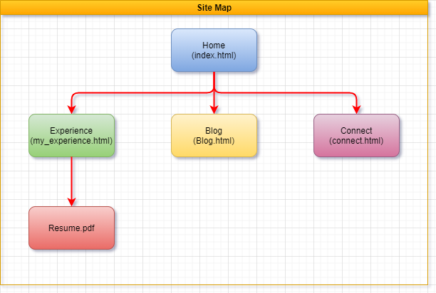
Site Map

Slide 3
Design process and decisions
The page was to have a minimalist feel to it.
Wanted to have the content to be displayed on tiles.
Wanted to have a separate menu for mobile used.
Needed to have symmetry across all pages.
Inspiration was taken from Youi insurance and Balter Brewery.

Slide 4
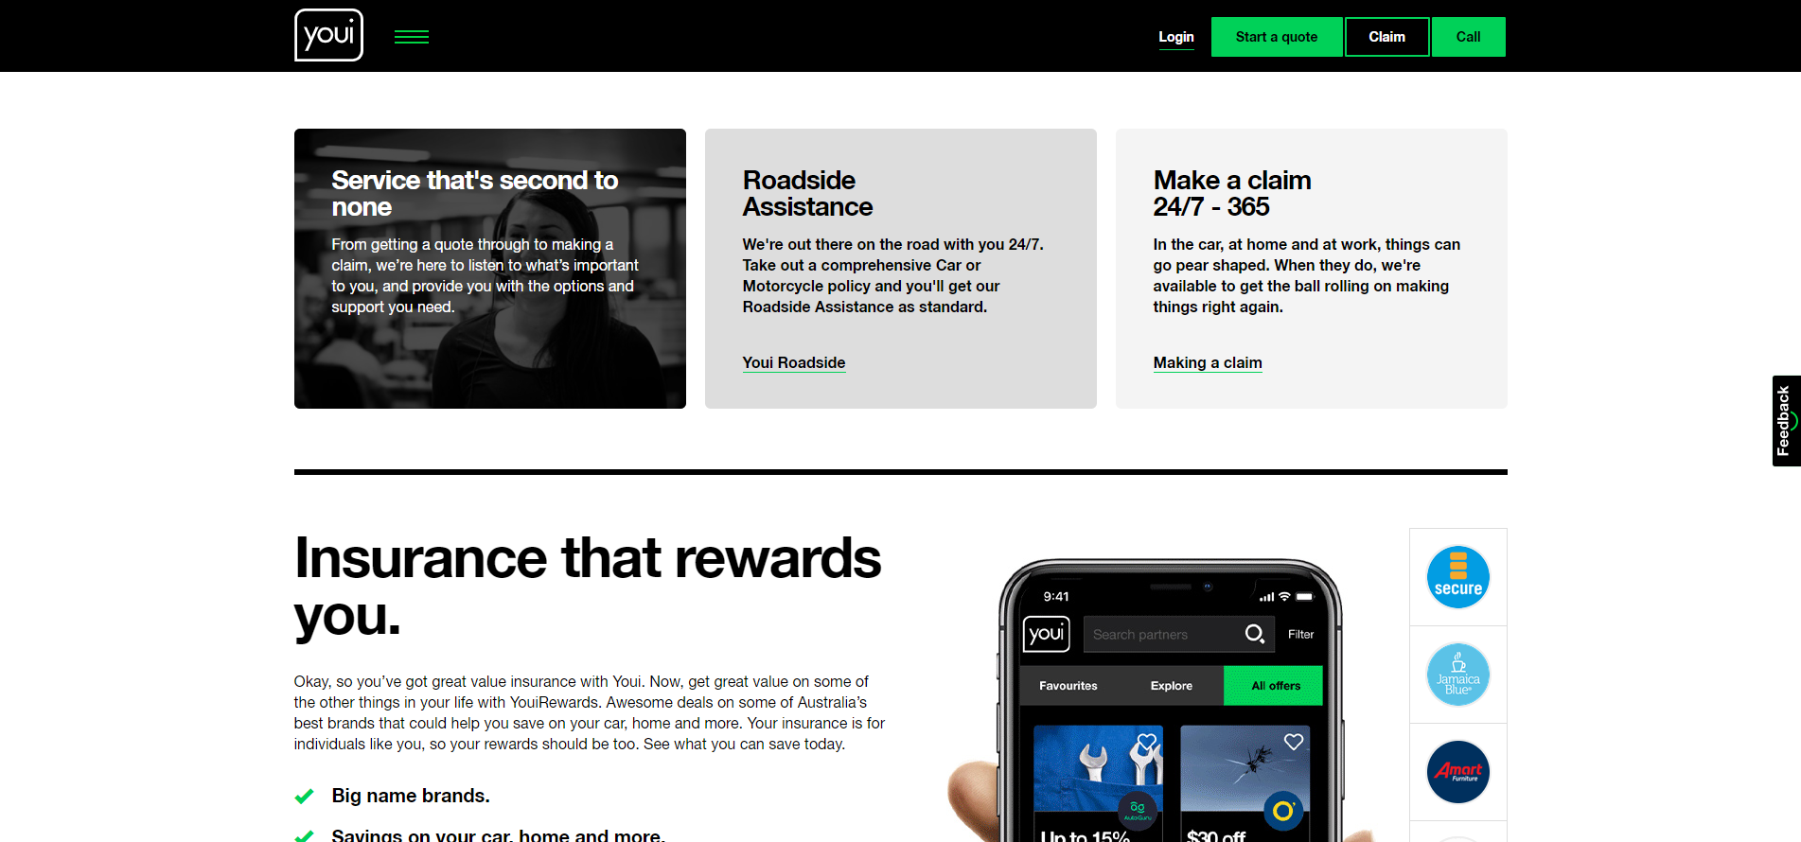
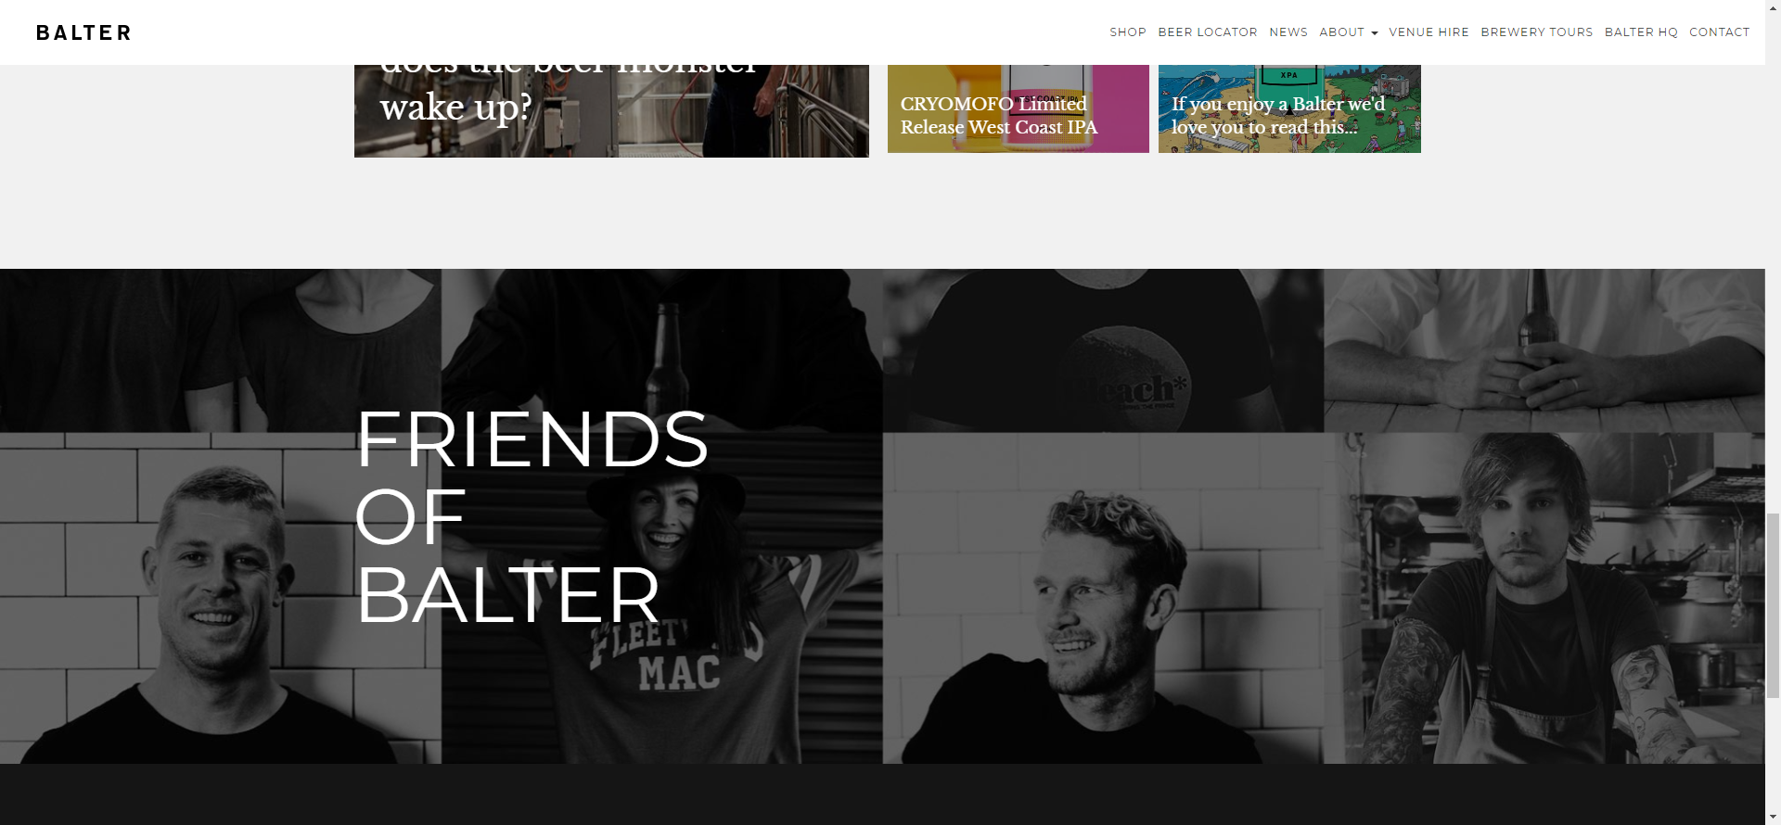
Inspirations

Slide 5
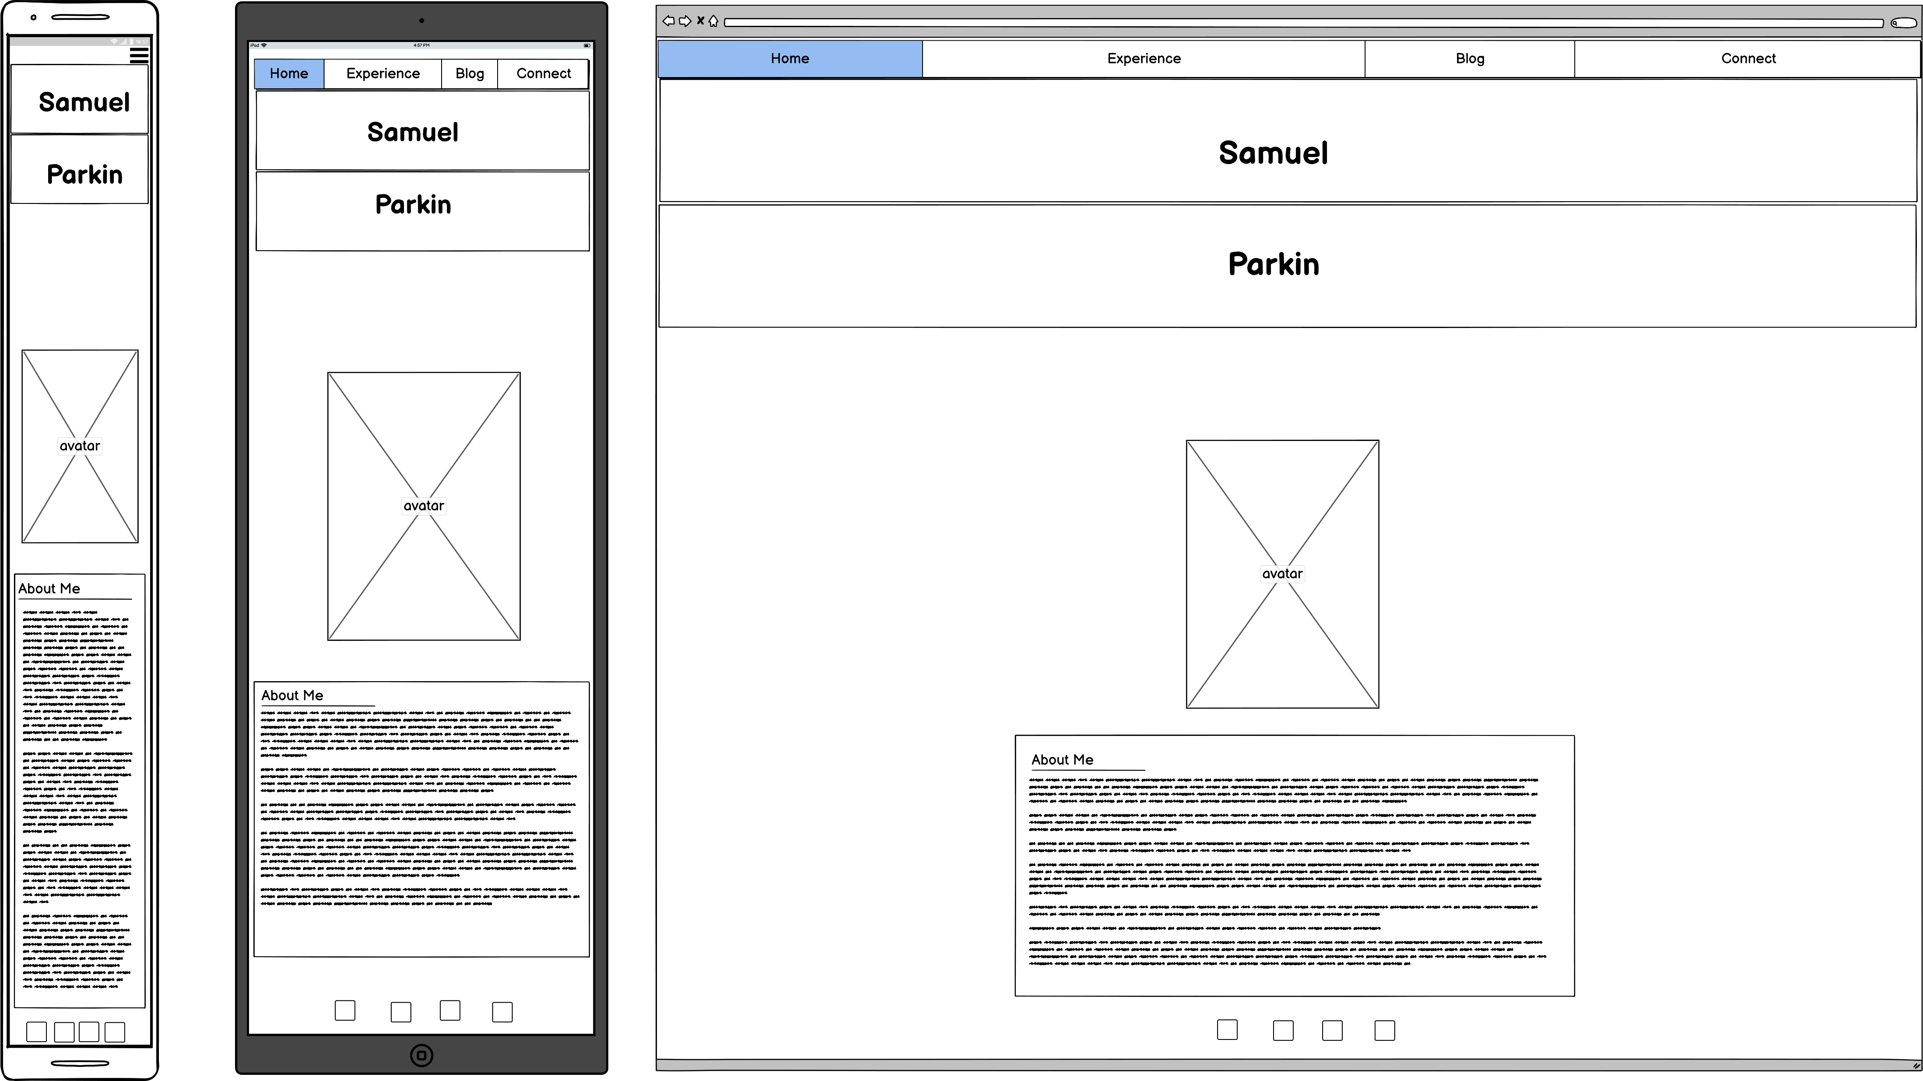
Wireframe of Home Page
Notes:
Your decision making process relating to the overall aesthetic of your website

Slide 6
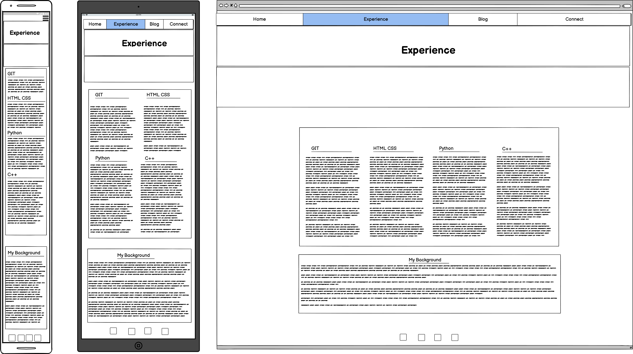
Wireframe of Experience Page

Slide 7
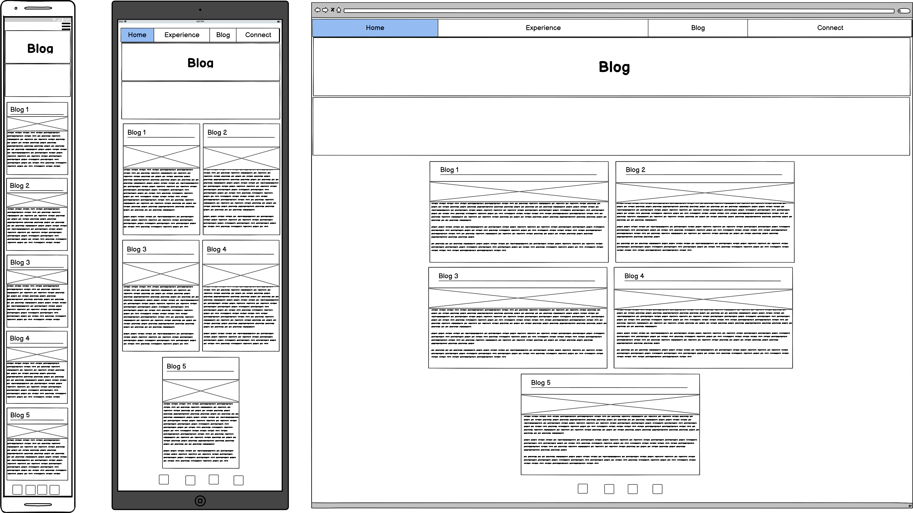
Wireframe of Blog Page

Slide 8
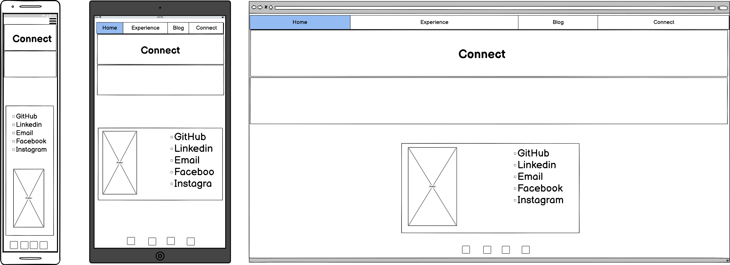
Wireframe of Connect Page

Slide 9
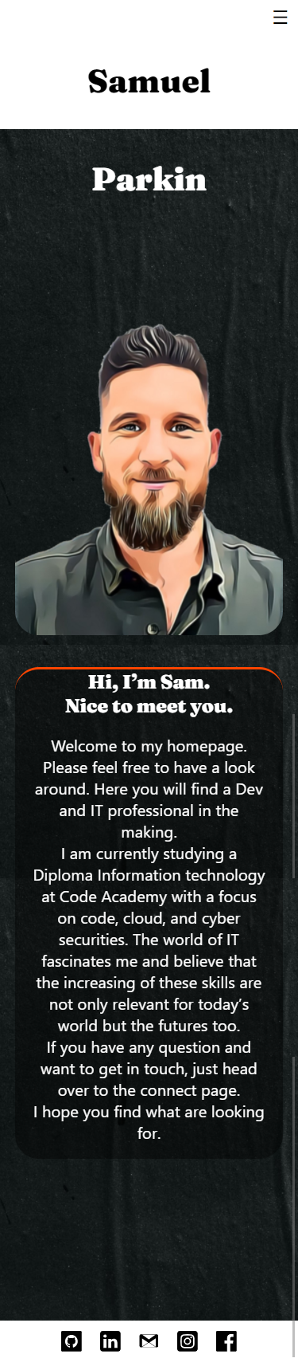
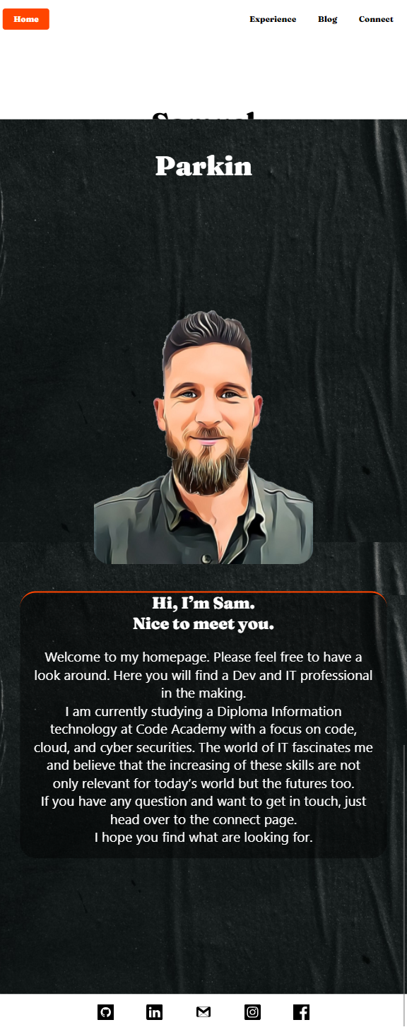
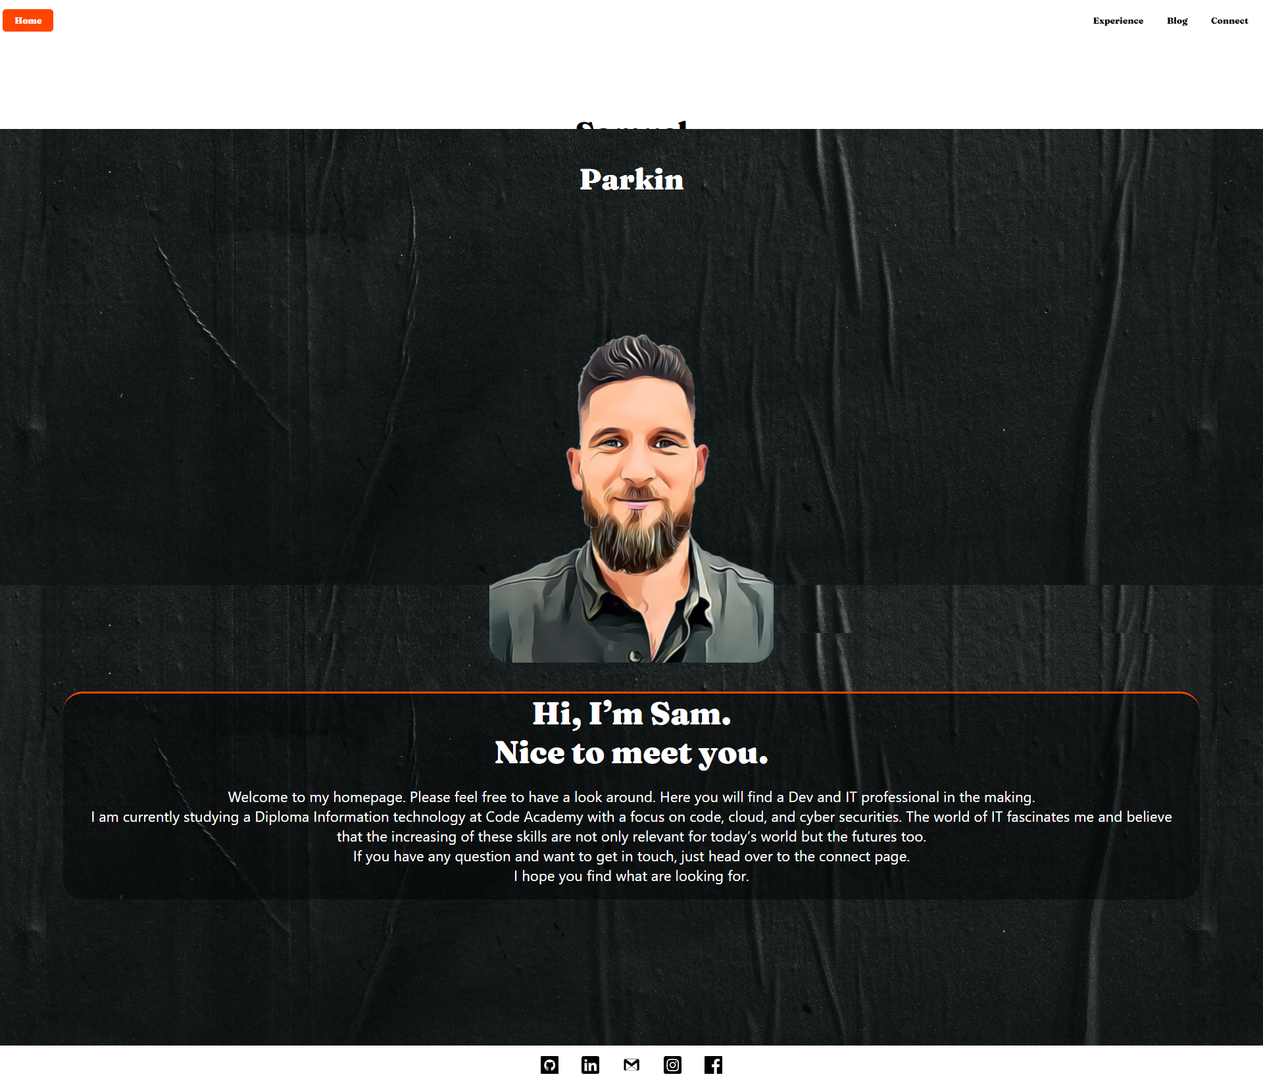
Portfolio Home Page

Slide 10
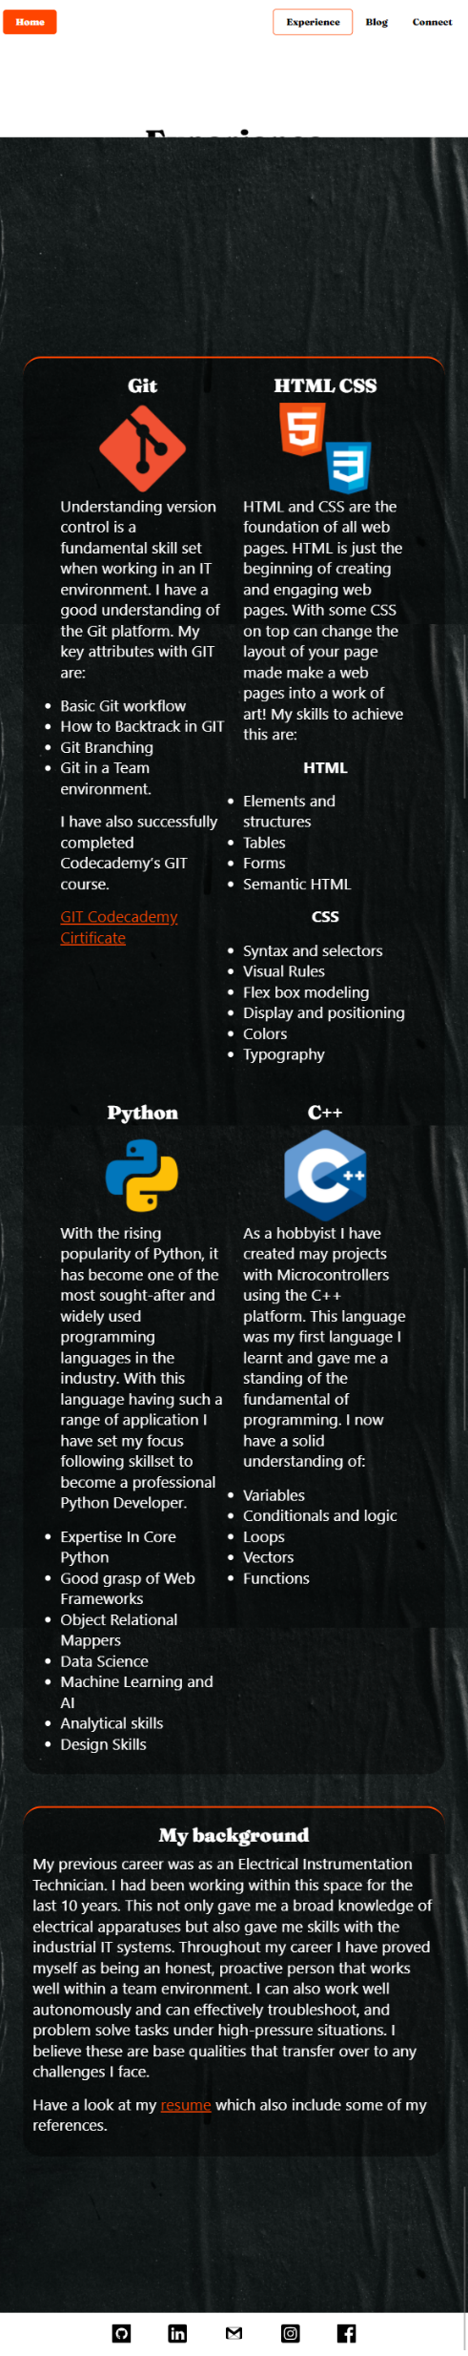
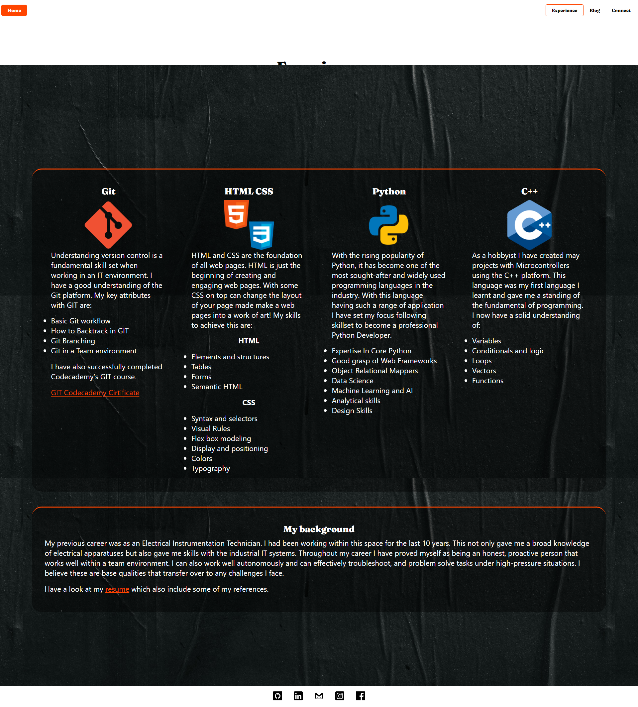
Portfolio Experience Page

Slide 11
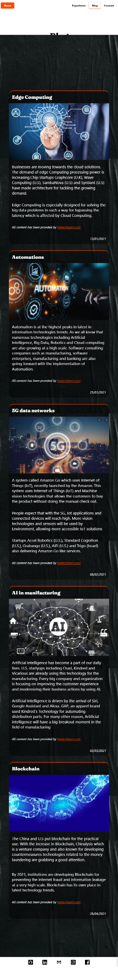
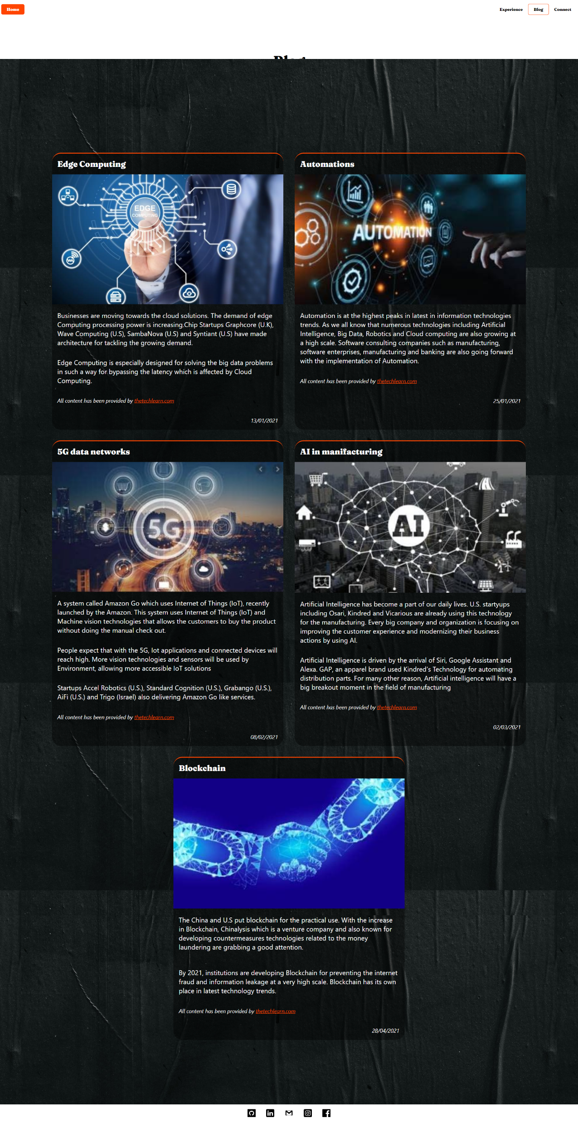
Portfolio Blog Page

Slide 12
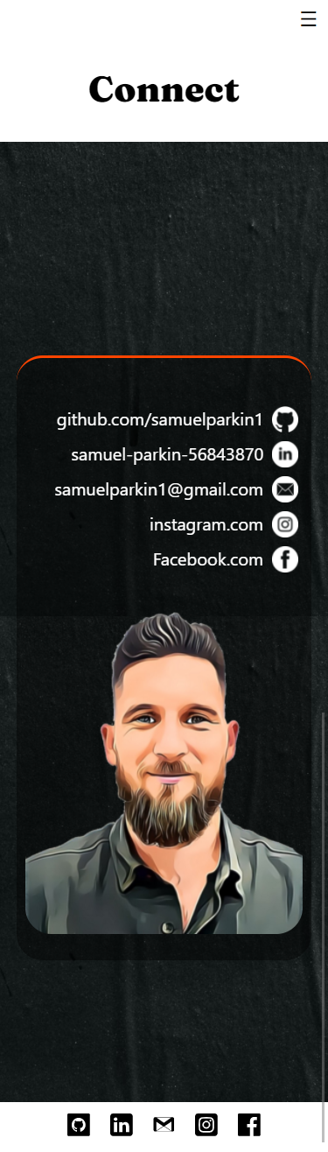
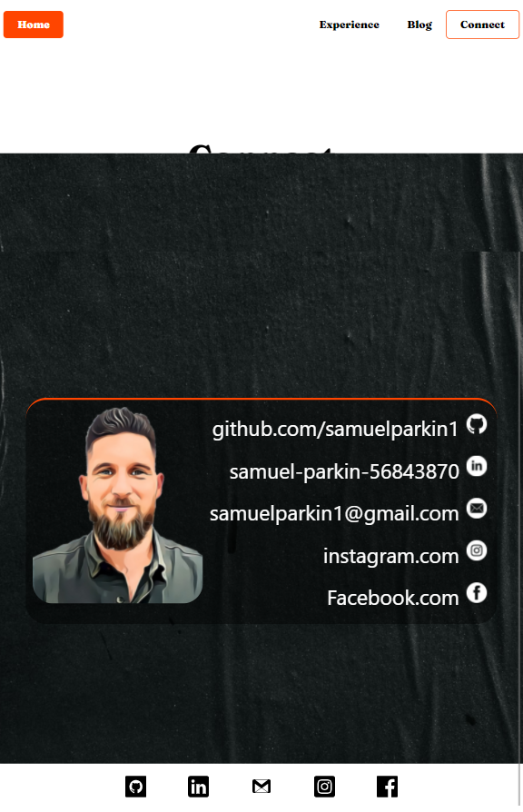
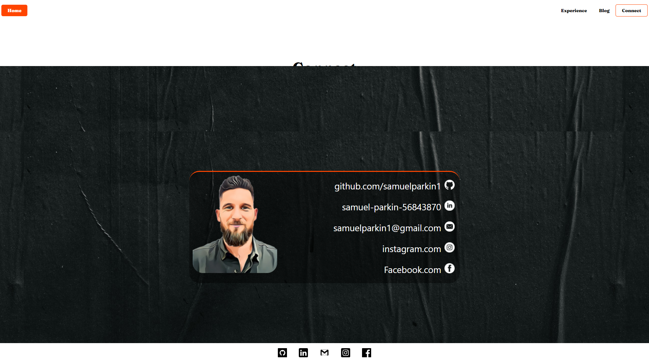
Portfolio Connect Page

Slide 13
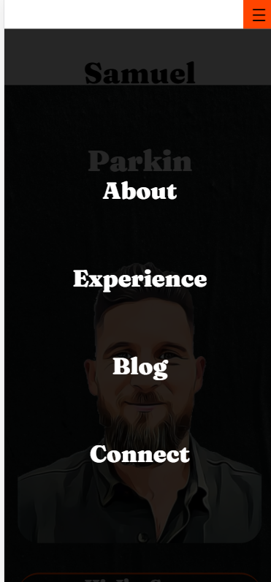
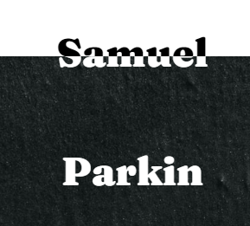
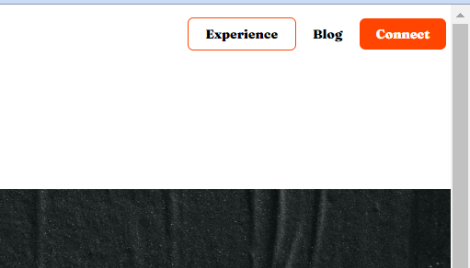
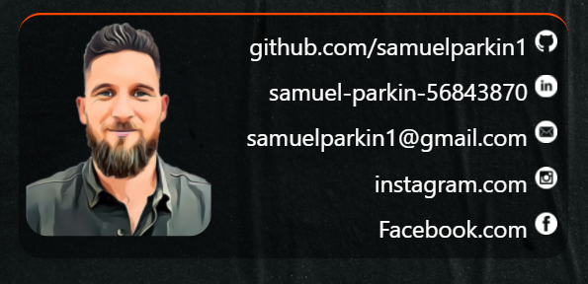
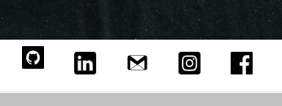
Components and features
Notes:
How components and styling will engage the audience

Slide 14
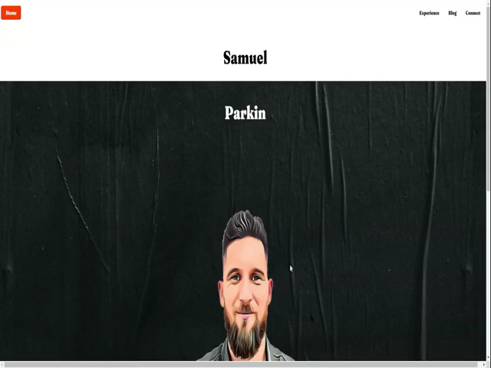
Video Walkthrough
Notes:
How components and styling will engage the audience

Slide 16
Challenges, ethical issues & favourite parts
Challenges:
Time management
Floating header
Design phase expectations vs build knowledge
Ethical issues:
Blog content and images are not my own.
Favourite parts:
Small wins after troubleshooting issues.
Having my first functioning website.

